Slide 1
Data Protection Impact Assessment (DPIA)
Overview of key considerations
Hugh Jones
Barberstown Castle
April, 2026

Slide 2
Table of Contents
Agenda Review & Introductions
Context Setting & DPIA Candidates
DPIA Methodology
The 7 Data Management Principles & Risk
Data Subject Rights
Post Assessment Actions & Report
Consultation with the Supervisory Authority
Next Steps on Participant DPIA Requirements
Privacy Engine Portal

Slide 3

Data Protection Impact Assessment
Essentially an exercise to anticipate and manage risk
Where changes to processing operations are likely to result in a high risk to the rights and freedoms of natural persons, the Controller will be required to carry out a Data Protection Impact Assessment
The objective is to evaluate:
    The risk origin
    The nature of the intended processing
    The severity of that risk and mitigation measures
    The risk ‘appetite’ of your organisation
    Current guidance from Regulator
    ‘State of the Art’ of relevant technology
    Consideration of alternative solutions
    Engagement of Regulator where substantial risk is identified

Slide 4

Data Protection Impact Assessment
The following conditions and measures should be taken into account when determining the
Appropriateness of conducting a Data Protection Impact Assessment:
    Where the personal data processing is likely to give rise to a risk to the data;
    Should involve the DPO and other, relevant stakeholders;
    Principle of Privacy by Design or Default
    Systematic evaluation of proposed processing;
    Identification of risk;
    Outline of the measures being taken to mitigate those risks;
    Outline of structures and measures planned to achieve compliance;
    Where substantial risk is identified and cannot be mitigated, the Data Controller must check with the Supervisory Authority.
    Monitor guidance from respective Supervisory Authority
    May change following case studies, investigations, penalties or prosecutions

Slide 5

What is the Context for the Change?
What is triggering the proposed change?
  Functional efficiency?
  Innovation?
  Competitive Advantage/Response?
  Process improvement?
  New processing functionality?
Who will be processing the data?
  In-house?
  Outsourced?
Other Considerations?
Who is sponsoring the change?
Where will the processing take place?
  Within the EEA?
  Overseas?

Slide 6
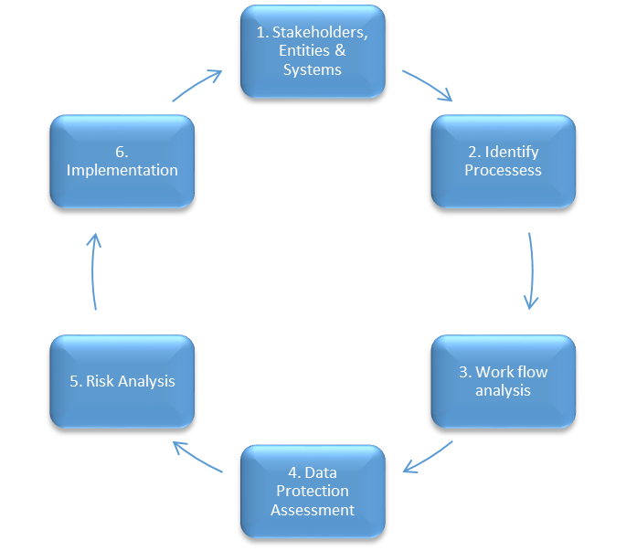
DPIA Methodology

Slide 7

Risk Considerations
Will the project involve the collection of new information about individuals?
Will the project compel individuals to provide information about themselves?
Will information about individuals be disclosed to organisations or people who have not previously had routine access to the information?
Are you using information about individuals for a new or different purpose?
Will the data now be used in a different way?
Environmental Considerations
  Changes to legislation/regulation (GDPR / Brexit / AI Act)
  Changes in Regulatory guidance or enforcement (Privacy Shield, Schrems II)
  Shift in market preferences towards/away from certain technologies
  Changes in work practices – Office-based v Working From Home (Covid-19)

Slide 8
What effect will the proposed change have?
Does the project involve using new technology which might intrude on personal privacy?
Will the project result in you making decisions which might have a significant impact on individuals?
Will the project result in introducing Automated Decision-making which has legal effect on the lives of Data Subjects?
Is the information about individuals which will be processed likely to raise privacy concerns or expectations?
Will the project result in new data being processed which was not previously available?
New technology being used? Processing within a new environment?
Automated Intelligence deployment – what data is being used to train the model/algorithm?
Are you processing ordinary or special categories of personal data?
Will the project require you to contact individuals in ways which they may find intrusive?
Will the proposed change require you to modify your lawful basis?

Slide 9

Characters within the DPIA
Data Subjects
Data Controller
Data Processor
Joint Controller/Data Sharing
Data Protection Officer
Supervisory Authority
Will these relationships change as a result of the project?

Slide 10
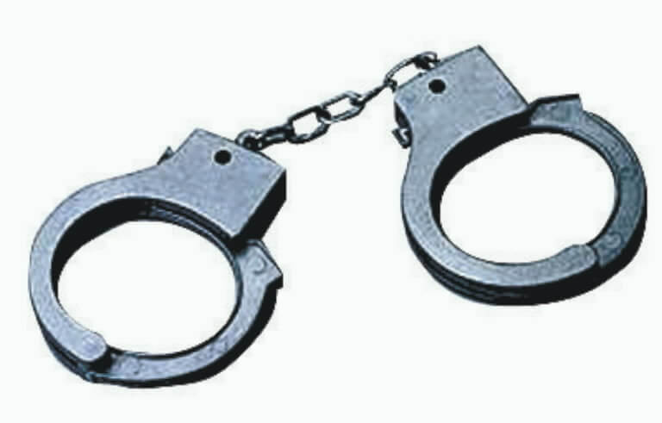
Accountability
Role of Data Controller - Primary point of compliance
  Process Logging/ RoPA
  Data Protection Impact Assessment
  Response to Data Subject Rights
Role of Data Processor - Mandatory contract in place
  Process Logging / RoPA
  Due Diligence criteria
  Liability for Sub-contractors
Role of Data Protection Officer - Dedicated role within the organisation
Not necessarily an employee
Individual Liability of Board members (to be determined)

Slide 11

DPIA Planning
Understand the current processing activity (prior to change)
Understand the proposed change and options available
Consider the implications for:
  Data management processes and data quality
  Decision-making responsibility and accountability
  Stakeholder involvement and outsourcing
  Regulatory obligations, esp in light of new obligations
  Guidance of Supervisory Authority
  Jurisdictional considerations and data transfers
  Changes to the original lawful basis for processing
  De-commissioning of existing arrangements
  Changes in staff working conditions
  Re-use of legacy data for another purpose

Slide 12

GDPR Principles
Fair, Transparent and Lawful Processing
Purpose Limitation
Minimisation of Processing
Data Accuracy/Data Quality
Retention, Storage Limitation
Security and Confidentiality
Liability and Accountability
Respect for Data Subjects’ individual rights (Articles 15 – 22)

Slide 13

Risk Evaluation
Risk Likelihood
  ‘1’ – Most unlikely, rarely happens, to …
  ‘5’- Highly likely, almost guaranteed to occur
Risk Impact
  ‘1’ – Negligible impact to …
  ‘5’ - Catastrophic, damaging to brand, reputation
Strength of proposed solution
  ‘1’ – Likely to be largely ineffective – It is out of our control to influence outcomes, to …
  ‘5’ – Likely to fully mitigate the effect of the risk event
Risk Value = (Likelihood Value * Impact Value) / Strength of Solution
Consideration should be given to vulnerability of Data Subjects
Caution! – Risk evaluation tends to be very subjective – both organisational and individual!

Slide 14

Security Implications
What Technical and Organisational Measures (TOMs) are already in place?
What additional TOMs are being considered?
Are the TOMs adequate and appropriate for the proposed change?
Are the TOMs appropriate for the format and structure of the data?
Will new or additional staff have access to the data? (Article 28 contracts)
Will the data leave the jurisdiction? The EU? (Schrems II rules)
Are formal data transfer mechanisms in place (BCR, SCC, Data Transfer Framework, Code of Conduct)?
Is the intended destination a ‘Safe’ country? (14 at last count, including post-Brexit UK)
How big is the proposed data set?

Slide 15

Impact on Data Subject Rights
The Right to be Forgotten (Right to Erasure)
The Right to Restriction of Processing
The Right to Object to Certain Processing
The Right to Data Portability
The Right of Access to One’s Personal Data
Rights in relation to Profiling and Automated Decision Making
Right to request portability of one’s data to another Controller
One-month response time applies to all Data Subject Rights, with a 60-day extension available

Slide 16
Assessment Questionnaire
Suggested Template (others are available!)
Pre-Assessment Evaluation
  Is a DPIA necessary?
Questionnaire
  Stakeholders
  Justification
  Data Use
  Consideration of Alternatives
Input from multiple Stakeholders

Slide 17
Post-Assessment Actions
Once the DPIA questionnaire has been completed:
    Document the Risk Assessment findings
    Seek objective/external review of risk evaluation, if necessary
    Document the proposed solutions, with clear narrative of design changes
    Seek senior management sign-off of risk management solution
    Document and file the DPIA conclusion with any conditions/caveats
    Re-visit perceived risks regularly to re-evaluate

Slide 18
The Impact Assessment Findings Report
Article 35.7.
The assessment shall contain at least:
(a) a systematic description of the envisaged processing operations and the purposes of the processing, including, where applicable, the legitimate interest pursued by the controller;
(b) an assessment of the necessity and proportionality of the processing operations in relation to the purposes;
(c) an assessment of the risks to the rights and freedoms of data subjects referred to in paragraph 1; and
(d) the measures envisaged to address the risks, including safeguards, security measures and mechanisms to ensure the protection of personal data and to demonstrate compliance with this Regulation taking into account the rights and legitimate interests of data subjects and other persons concerned.

Slide 19

Assessment Report Structure
Executive Summary
Introduction
Outline of Proposed Change
Evaluation of associated risks
Risk mitigation measures required
Assessment Recommendation
  Proceed based on risk mitigation measures
  Terminate based on unacceptable risks
  Suspend while scope and approach are re-considered

Slide 20
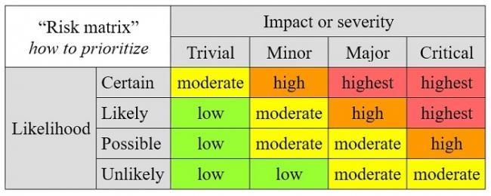
Risk Management and Mitigation
Consider appropriate solutions to manage perceived risks
  Mitigate the impact
  Reduce likelihood of risk event
  Avoid the perceived risks altogether
  Outsource and deflect the risk
Demonstrate evidence of risk management methodology
Add perceived Major and Critical risks to organisation’s Risk Register
Include deployment of Risk Mitigation measures in Project plan

Slide 21

Prior Consultation with DP Commission
Article 36
1. The Controller shall consult the supervisory authority prior to processing where a data protection impact assessment under Article 35 indicates that the processing would result in a high risk in the absence of measures taken by the Controller to mitigate the risk.
2. Where the supervisory authority is of the opinion that the intended processing … would infringe this Regulation, ….or
5. Member State law may require Controllers to consult with, and obtain prior authorisation from, the Supervisory Authority in relation to processing by a Controller for the performance of a task carried out by the Controller in the public interest, including processing in relation to social protection and public health.

Slide 22
Consultation with the DPC
Article 36.3.
When consulting the Supervisory Authority (regarding the DPIA), the Controller shall provide the Supervisory Authority with:
  the respective responsibilities of the Controller, Joint Controllers and Processors involved in the processing, in particular for processing within a group of undertakings;
  the purposes and means of the intended processing;
  the measures and safeguards provided to protect the rights and freedoms of Data Subjects pursuant to this Regulation;
  where applicable, the contact details of the Data Protection Officer;
  the Data Protection Impact Assessment Report (as per Article 35); and
  any other information requested by the Supervisory Authority.

Slide 23
Response from DP Commission
Article 36.2
Within a period of up to eight weeks from receipt of the request for consultation, the Supervisory Authority shall
  provide written advice to the Controller / the Processor, and
  may use any of its powers referred to in Article 58.
  That period may be extended by six weeks, taking into account the complexity of the intended processing.
  Those periods may be suspended until the Supervisory Authority has obtained information it has requested for the purposes of the consultation.

Slide 24
Thanks!
Any Questions?

